Slide 1

INTEGRATING MENSTRUAL HYGIENE MANAGEMENT INTO HUMANITARIAN RESPONSE
STAFF TRAINING MODULE

Slide 2






OVERVIEW
Module 1
Module 2
Menstruation Basics
Effective Menstrual Hygiene Management (MHM) Response
Cross-sectoral response coordination
Menstruation challenges in emergencies
MHM Response for Vulnerable Populations

Slide 3
MODULE 1
MENSTRUATION BASICS AND CHALLENGES

Slide 4
MENSTRUATION BASICS
MODULE 1 SECTION 1

Slide 5

THE ISSUE
Over 26 million displaced girls and women are estimated to be menstruating
Without access to good menstrual materials and private toilets or spaces for changing, girls and women may not want to go far from home.
Teachers may miss school, health workers may miss work, and girls and women may not attend school, go to the market or wait in line for supplies.

Slide 6
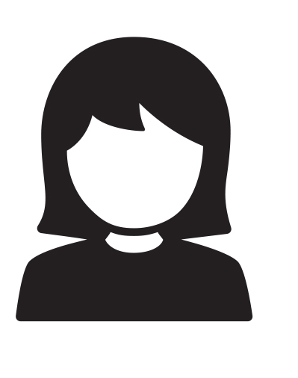
MENSTRUATION
Menstruation: the monthly release of a mixture of blood and tissue
Every month, the inside lining of the uterus swells to prepare for a possible pregnancy.
If no pregnancy occurs, the uterus sheds its inside lining as part of menstruation.
Typically a menstrual period lasts 2-7 days.
The amount of blood is small, usually between 1-6 tablespoons, but can be very inconvenient, especially if unexpected.

Slide 7
DURATION AND FLOW
Regular Periods
Irregular Periods
2 – 7 days
May be somewhat painful, with cramps
and bloating
Vary; 2 – 7+ days
A girls first period (called menarche) may be irregular
Day 1:
Day 4-7:
Heavy Blood Flow
Light Blood Flow

Slide 8
SYMPTOMS
Symptoms related to changes in hormones during menstruation may include:
Pain (cramps, low back pain, headaches)
Discomfort
Bloating
Weight gain
Feeling happier than usual
Feeling sadder than usual
HORMONES CONTRIBUTE TO PHYSICAL AND EMOTIONAL CHANGES DURING MENSTRUATION.

Slide 9
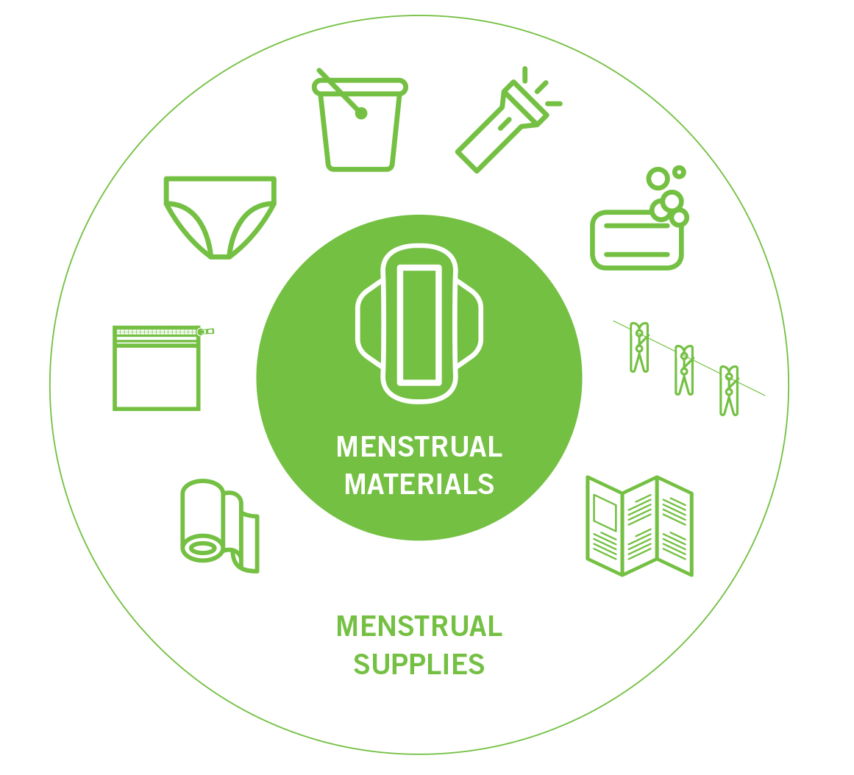
MATERIALS & SUPPLIES
Menstrual materials refers to the materials used to catch blood. This could be a pad, piece of cloth, tampon, cup or any other preferred method.
Menstrual Supplies refers to the other supportive items needed to support the management of menstruation (e.g. soap, a bucket, underwear, a clothesline).
Providing only pads (or cloth) is not enough!

Slide 10
MATERIALS & SUPPLIES
Preferences will differ person to person. Here are some examples:
Age
Sometimes, older women prefer cloth while younger girls prefer disposable pads.
Culture
Sometimes, women prefer cloth and find sanitary pads uncomfortable.
Sometimes, women prefer disposable pads due to lack of available water for washing reusable materials.
Region
Circumstance
During emergencies, girls and women may prefer familiar materials in order to focus on survival.

Slide 11

VARIATION
Girls and women will experience variation in:
Heaviness of the menstrual period
Length of menstrual period
Extent of symptoms, pain & discomfort
Material and supply preferences
EVERY WOMAN EXPERIENCES HER PERIOD DIFFERENTLY.

Slide 12
MODULE 1
SECTION 2
MENSTRUATION CHALLENGES IN EMERGENCIES

Slide 13

BARRIERS TO MANAGING MENSTRUATION
Embarrassment and Anxiety
Lack of Information
Cultural Taboos and Restrictions
Facility - related
Menstrual Material - related
When living in an emergency context, girls and women experience specific challenges that hinder their ability to properly manage menstruation.

Slide 14
EMBARRASSMENT AND ANXIETY
Social norms may lead women and girls to feel that menstruation is dirty, shameful and unhealthy.
Bloodstains on clothing and worries about menstrual leaks prevents girls and women from partaking in daily activities (e.g. going to school, the market or distributions).
Menstruation is very personal. Women and girls often do not want others to know they are menstruating, even other women and girls.

Slide 15

LACK OF INFORMATION ON MENSTRUATION
  Girls generally first learn about menstruation from their mothers, friends & sisters
  This information is often a mixture of cultural beliefs, superstition and practical information.
  In some cultures mothers may feel uncomfortable to talk to their daughters about menstruation because it is linked to readiness to have sex.

Slide 16
LACK OF INFORMATION ON MENSTRUATION
Girls and women in emergencies need basic menstrual hygiene and health education on:
Menstrual hygiene practices, including washing, drying, disposal and waste management of menstrual materials.
Menstrual health behaviors and basic reproductive health education on menstruation (especially adolescent girls).
Addressing misconceptions regarding MHM that may be prevalent within that culture.

Slide 17
CULTURAL TABOOS AND RESTRICTIONS
Cultural beliefs may limit the types of materials used and complicate how used materials can be disposed of, washed and dried.
In your local context, do you know of any actions that girls and women cannot partake in?

Slide 18
EXAMPLES OF COMMON MISCONCEPTIONS
Common misconceptions
Facts
Menstrual bleeding is a sign of sickness.
Menstruation is a sign of a health reproductive system, even if there is some pain or discomfort.
Showering during menstruation will cause illness.
There’s no reason to change your hygiene habits while on your period. If anything, showering during menstruation will help prevent illness.
Girls and women should not handle food or be in the kitchen during menstruation.
Handling food or being in the kitchen during menstruation will not ruin the meal.

Slide 19

FACILITY-RELATED CHALLENGES
Reasons girls and women may not use facilities provided for MHM:
Lack of privacy in public or shelter facilities
Feel unsafe
Facilities are dirty
Lack of locks
Water source is not convenient
No separation of gender at toilets
No carrying case for used materials
Facilities are dirty

Slide 20


MENSTRUAL MATERIAL CHALLENGES
Materials may not be easily accessible or affordable.
Girls and women may need underwear or an incorrect size is provided.
Girls and women may lack supportive supplies needed to maintain reusable options (e.g. soap, a carry bag, bucket).
Shortages in the quantity of materials may cause girls and women to reuse materials that are still damp or drying, resulting in discomfort and irritation.

Slide 21
MODULE 2
MENSTRUAL HYGIENE MANAGEMENT (MHM)

Slide 22
MODULE 2
SECTION 1
EFFECTIVE MHM RESPONSE

Slide 23
MENSTRUAL HYGIENE MANAGEMENT
What is MHM?
A range of interventions found necessary and appropriate for ensuring that adolescent girls and women can privately and safely manage their menstrual period.

Slide 24
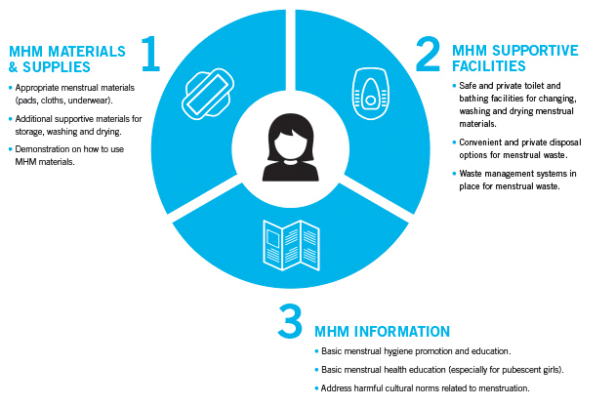
BASIC COMPONENTS OF RESPONSE

Slide 25
KEY ACTORS IN MHM RESPONSE
Education
Protection
NFI’s
WASH
Health
Shelter and Camp Coordination Camp Management (CCCM) can also support MHM programming.

Slide 26
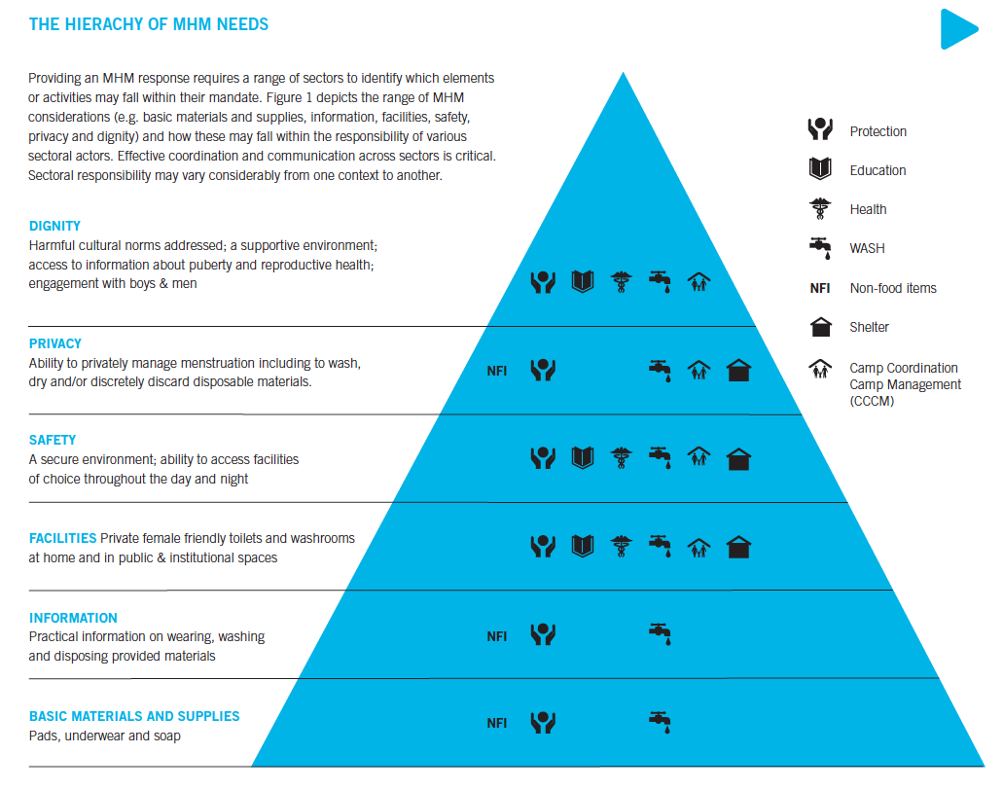
HIERARCHY OF MHM NEEDS

Slide 27



THE 4 C’S
Effective MHM programming requires the following:
Coordination
Culture
Communication
Consultation

Slide 28
COORDINATION
Generate consensus on MHM through interagency, camp coordination and management, and cluster meetings.
Partner with other agencies to maximize impact and minimize gaps or overlap.
Create strong partnerships between WASH and Protection actors, with engagement of other sectors.
Delegate MHM focal person(s) from WASH and Protection to track mainstreaming.

Slide 29
CULTURE
Understand cultural sensitivities and beliefs around MHM.
Culture may have direct implications for selection of materials, facility design, waste management, disposal, etc.
Assess staff comfort levels and sensitivities on menstruation to inform capacity building trainings.
Trainings can promote the mainstreaming of MHM across sectors.

Slide 30
COMMUNICATION
On-going communication with MHM focal person(s) and working groups across relevant sectors.
Update partners on programming, beneficiary feedback, lessons learned, challenges.
Communicate directly with beneficiaries about MHM.
Ensure beneficiaries understand how to use MHM supplies, dispose menstrual waste, have access to MHM education.

Slide 31
CONSULTATION
MHM is private and personal, but girls/women are usually willing to talk about it given the opportunity.
Appreciate that one-size-fits-all solutions are not ideal for something so personal.
Consult with girls and women on MHM programming, materials, supplies, facilities, information needs.
Share learning across sectors and continue consultation (FGD, PDM, interviews).

Slide 32
MODULE 2
SECTION 2
CROSS SECTORAL RESPONSE AND COORDINATION

Slide 33


WASH
Girls and women need private and safe spaces to discreetly:
Change used MHM materials
Hygienically dispose of used materials
Wash cloth, reusable pads, or underwear
Dry cloth, reusable pads, or underwear
Bathe or cleanse themselves.
SOME GIRLS/WOMEN MAY PREFER USING SHARED TOILETS OR WASHROOMS FOR WASHING, OTHERS MAY PREFER THEIR OWN HOME.

Slide 34
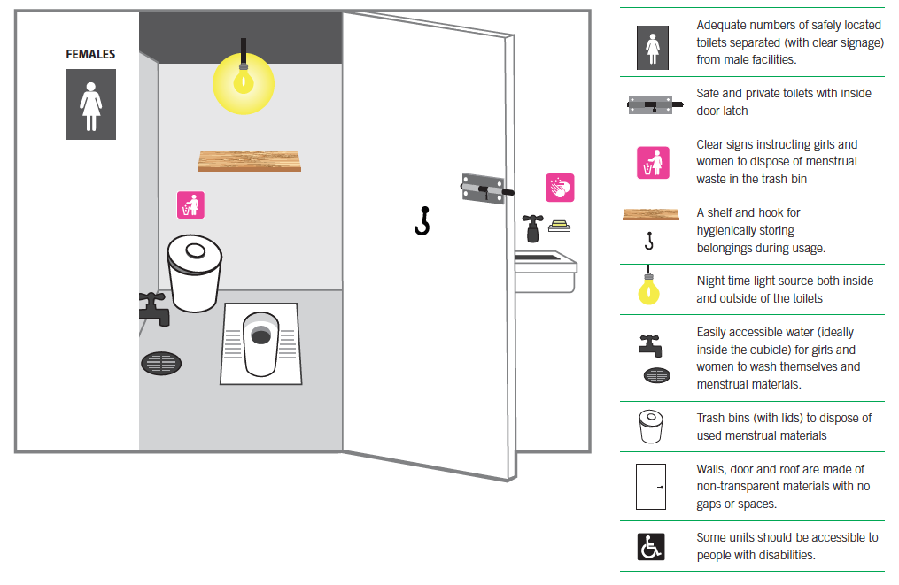
FEMALE FRIENDLY TOILET

Slide 35
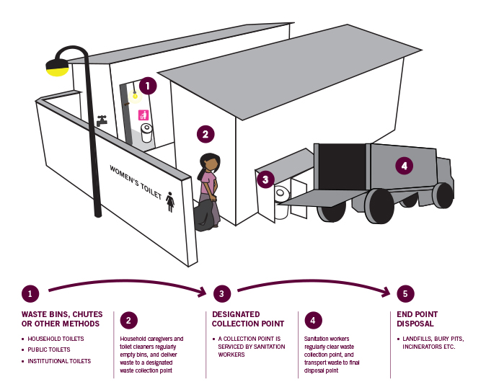
MENSTRUAL WASTE SYSTEM

Slide 36
WASH – COLLABORATION
Examples of opportunities for cross-sectoral collaboration:
Collaborate with NFI distributions and Education and Protection actors to provide demonstrations on how to wash and dispose menstrual materials and provide menstrual hygiene education.
Visit institutional facilities (health, school or protection center toilets or washrooms) regularly for maintenance or adjustment.
Work with Protection or Education actors to gather feedback from women and girls about the facilities.
Share learning from monitoring data collected with relevant sectoral actors.

Slide 37



EDUCATION
MHM Considerations to positively impact girl’s participation in school:
Female-friendly and safe WASH facilities with water, soap and disposal
Train staff to support girls at critical times and ensure girls have basic knowledge of MHM
Adequate emergency stock of menstrual supplies are available, including underwear
IN MANY RESOURCE POOR SETTINGS, MENSTRUATION CAN NEGATIVELY IMPACT A GIRL’S EDUCATION.

Slide 38


PROTECTION
MHM Considerations for women’s safe spaces, CFS and youth centers:
Private and safe female friendly WASH facilities with water, soap and disposal options.
Serve as a safe and private venue for the provision of basic education on MHM, including menstrual hygiene and menstrual health.
Adequate emergency stock of menstrual supplies are available, including underwear
PROTECTIVE SPACES MAY ALSO BE IDEAL FOR SOLICITING SENSITIVE FEEDBACK FROM GIRLS AND WOMEN ON MHM.

Slide 39


HEALTH
MHM Considerations for health professionals:
Include menstruation question in health screening and maintain emergency stock of menstrual materials for unprepared clients.
Provide pain medication for girls and women with severe menstrual pain.
Girls and women with certain clinical indications may require additional MHM materials (for example post-partum bleeding, contraceptive related breakthrough bleeding, post-abortion bleeding or incontinence).

Slide 40


HEALTH
General MHM considerations in health settings:
Provide female friendly toilets in outpatient and inpatient settings.
Incorporate menstruation into routine health education activities.
Provide material and supply demonstrations to patients.

Slide 41
HEALTH - COLLABORATION
Examples of opportunities for cross-sectoral collaboration:
Collaborate with education actors in providing basic menstrual health education to girls in schools.
Collaborate with Protection actors in providing basic menstrual health education in women centers, child-friendly spaces or youth centers.
Collaborate with NFI’s and WASH actors in providing menstrual health education during MHM distributions.
ADOLESCENT GIRLS ARE OFTEN LESS LIKELY TO SEEK CARE AT HEALTH FACILITIES FOR REPRODUCTIVE HEALTH SERVICES.

Slide 42
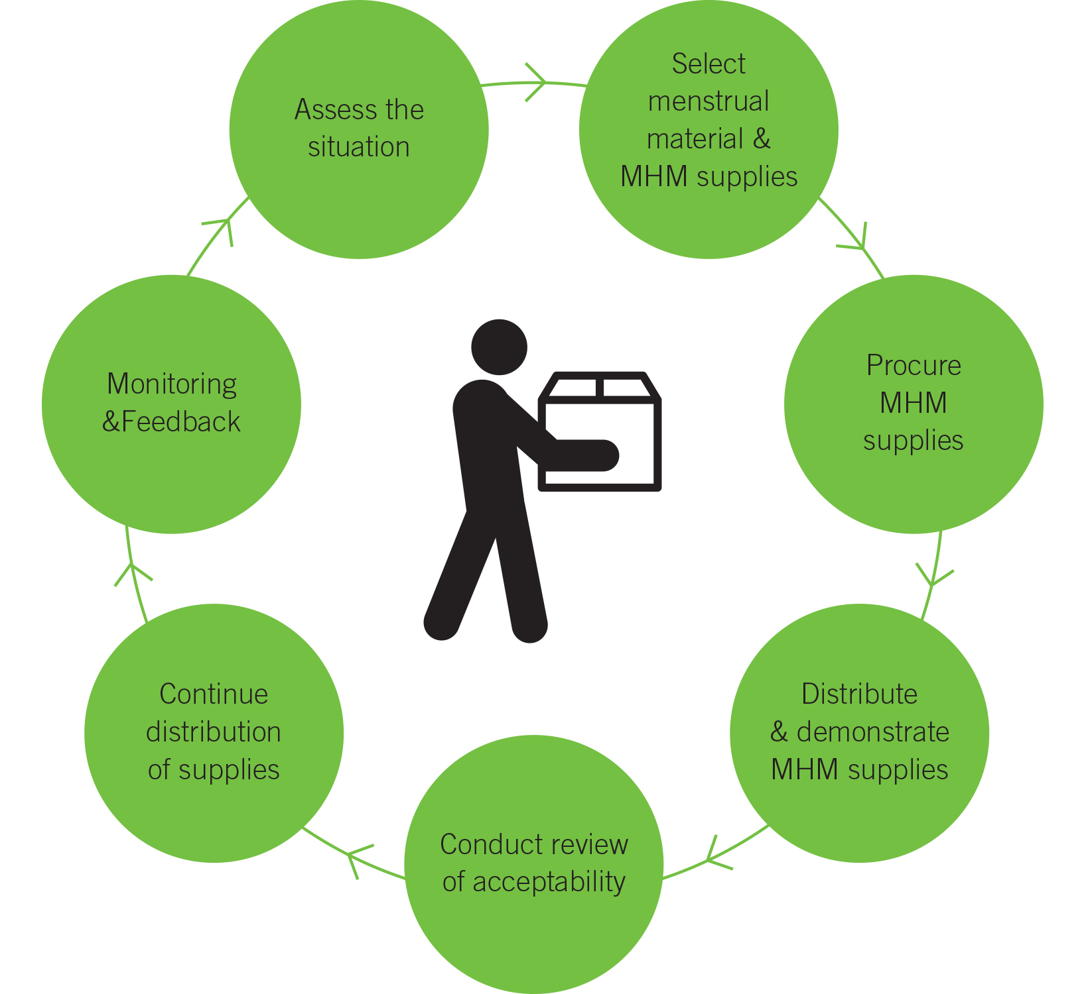



NFI
MHM NFI Considerations to Support the Washing and Drying of Materials:
MHM-designated buckets or basins
(separate from buckets used for cooking or laundry)
Additional laundry soap to wash menstrual materials
Clothesline and clips to ensure menstrual materials can be dried separately

Slide 43
NFI
MHM considerations when providing MHM-related NFIs:
Consult girls and women to ensure that appropriate menstrual materials are selected.
Be sensitive when planning MHM distributions including ensuring for private, safe locations and to be led by female staff.
Provide demonstrations on the use of MHM materials, as many girls and woman may not be familiar with the materials provided.
Solicit feedback directly from girls and women to ensure that the materials and supplies are appropriate and being utilized.

Slide 44
PROJECT CYCLE FOR MHM DISTRIBUTIONS

Slide 45
MODULE 2
SECTION 3
MHM RESPONSE FOR KEY POPULATIONS

Slide 46


MHM CHALLENGES - TRANSIT
Upon leaving or fleeing their homes & traveling, women and girls may…
Lack menstrual materials
Lack access to toilets or washrooms for managing menstruation.
Have to go into forests or alleyways to find discreet places to change, creating safety concerns.
Be unable to clean used materials, clothing or find water.
When arriving at their next destination (e.g. border crossing), women and girls may…
Feel embarrassment if clothing has been spoiled by blood
Need basic MHM materials and supplies
Need access to female friendly toilets

Slide 47
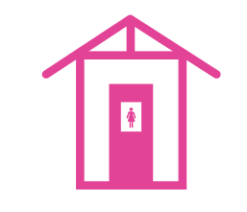

MHM CONSIDERATIONS - TRANSIT
Upon arrival to a reception centers, women and girls may need…
Basic MHM materials and supplies
Access to female friendly toilets
Quick MHM material demonstration and education
Upon arrival at camp, women and girls should…
Be directly consulted on their MHM needs and preferences to ensure that appropriate methods and solutions are designed.
Have access to longer term solutions for ensuring access to MHM materials, taking into account issues of sustainability.
Have access to female friendly toilets and bathing spaces.
Have continuous education and/or information sharing on MHM

Slide 48

MHM CHALLENGES - DISABILITY
Girls and Women with disabilities have unique challenges with MHM.
Physical disabilities
WASH facilities may not be accessible
Visual disabilities
Unable to see leaks or extent of blood
Developmental disabilities
May be unable to communicate discomfort or pain.
May need washing or changing their menstrual materials.
May change in inappropriate places
May need washing or changing their menstrual materials.
May need washing or changing their menstrual materials.

Slide 49
MHM CONSIDERATIONS - DISABILITY
Identify and Consult Vulnerable Girls, Women & Caregivers
Restricted movements can make it difficult to identify and address the MHM-needs of vulnerable girls and women.
Provide additional MHM materials and supplies
It may be necessary to provide additional supplies of extra sanitary materials (pads, cloth, etc.). soap (bathing and laundry) and gloves (for caretakers).
Build Accessible Facilities
Develop facilities that address their unique needs and are designed through direct consultation with disabled girls, women and their caregivers.
Provide appropriate MHM education
Needs assessment activities should track households with vulnerable girls and women.
Tailor MHM education to account for their abilities and developmental level.
Make sure to target caregivers as well as they may be responsible for supporting MHM needs.

Slide 50

ADDITIONAL MHM RESOURCES
WaterAid’s Menstrual Hygiene Matters: http://www.wateraid.org/what-we-do/our-approach/research-and-publications/view-publication?id=02309d73-8e41-4d04-b2ef-6641f6616a4f
IFRC’s WatSan Wiki Page on Menstrual Hygiene Management: https://watsanmissionassistant.wikispaces.com/Menstrual+Hygiene+Management
Oxfam’s Women’s Menstrual Hygiene Needs in Emergencies Brief:
https://policy-practice.oxfam.org.uk/publications/womens-menstrual-hygiene-needs-in-emergencies-298990

